Slide 1
PM10 Air Pollution Analysis
Michael Trossbach
ST765

Slide 2
What is PM10 air pollution?
PM stands for particulate matter (also called particle pollution): the term for a mixture of solid particles and liquid droplets found in the air.
PM₁₀ (coarse particles) describes inhalable particles, with diameters that are generally 10 micrometers and smaller.
SOURCE: https://www.epa.gov/pm-pollution/particulate-matter-pm-basics#PM

Slide 3
Data
Response variable:
logarithm of the concentration of PM10 (micrograms per meter³ of air) at the given hour of day
Explanatory variables:
logarithm of the number of cars per hour
temperature 2 meters above ground (degree C)
wind speed (meters/second)
temperature difference between 25 and 2 meters above ground (degree C)
wind direction (degrees between 0 and 360)
hour of day
day number from October 01, 2001
Subsample of 500 observations from a data set collected by the Norwegian Public Roads Administration in the neighborhood of Alnabru in Oslo, Norway between October 2001 and August 2003.
DATA SOURCE: http://lib.stat.cmu.edu/datasets/PM10.dat

Slide 4
Analysis Objectives
Model PM10 concentration as a result of the given explanatory variables
Determine if the average level of pollution is different according to the:
time of day
season

Slide 5
Data Preparation
D
D
Create variable for period of day using hour of day variable (integer ranging from 1 - 24)
Early morning: 1 - 4
Mid morning: 5 - 8
Mid day: 9 - 12
Early afternoon: 13 - 16
Late afternoon: 17 - 20
Night: 21 - 24
Determine date of each observation
Start date (October 01, 2001) + number of days from start date (a variable included in data set)
Create variable for season
Spring: March - May
Summer: June - August
Fall: September - November
Winter: December - February

Slide 7
Initial Observations
There are very few observations (only one, in fact) included in this data subset that were recorded during the summer months.
Given that this observation is anomalous, I decided to exclude it from the data set.
Based on the seasons plot (ignoring summer), spring has the highest median PM10 concentration, followed by fall, then by winter.
Based on the times of day plot, there is a steady increase in median PM10 concentration, peaking during the early afternoon (1pm – 4pm) and then steadily declining afterwards.

Slide 9
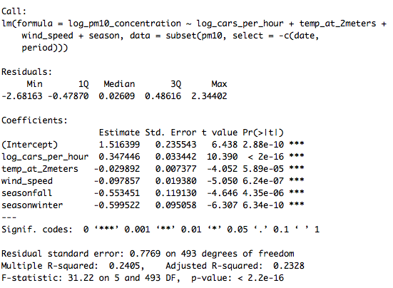
Linear Model w/out Interactions Stepwise Regression & Manual Pruning
After examining a complete model (no variables excluded except for the datetime variable ‘date’), I determined that the categorical variable ‘period’ indicating the time of day was insignificant.
Model with two variables excluded (‘date’ and ’period’) →

Slide 11
Linear Model w/ Interactions Stepwise Regression
Given the low adjusted R-squared value in the former model (0.2325), I experimented with adding interaction terms.
The following statement will provide a model containing all variables and all interactions between variables:
model = lm(response_variable ~ (.)^2, data=data_set)
I excluded the datetime variable ‘date’ and then used backward stepwise regression to prune the model →

Slide 12
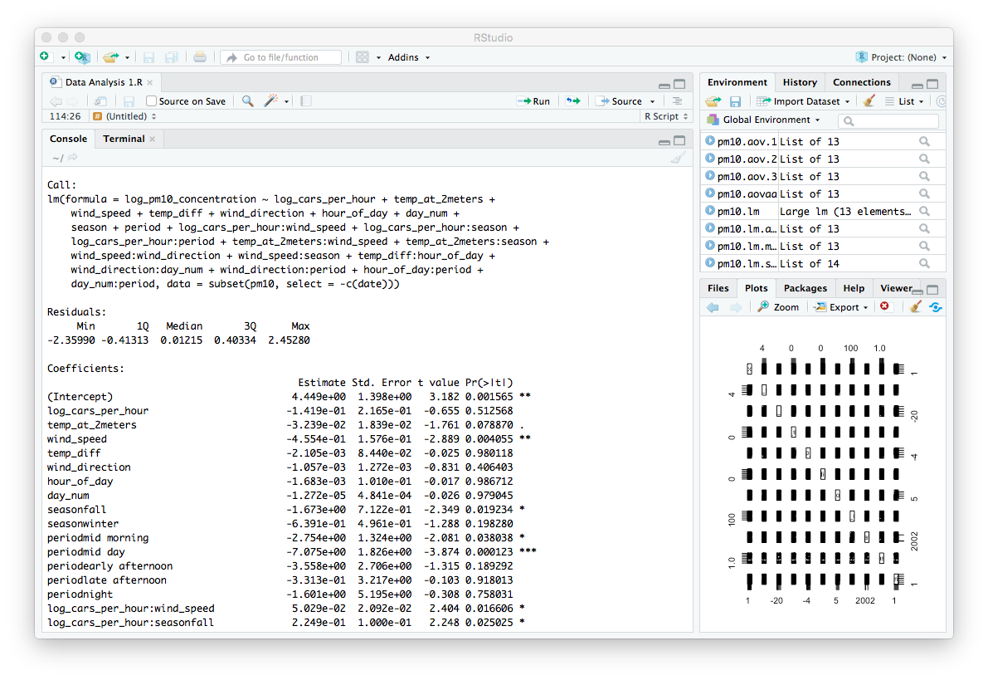
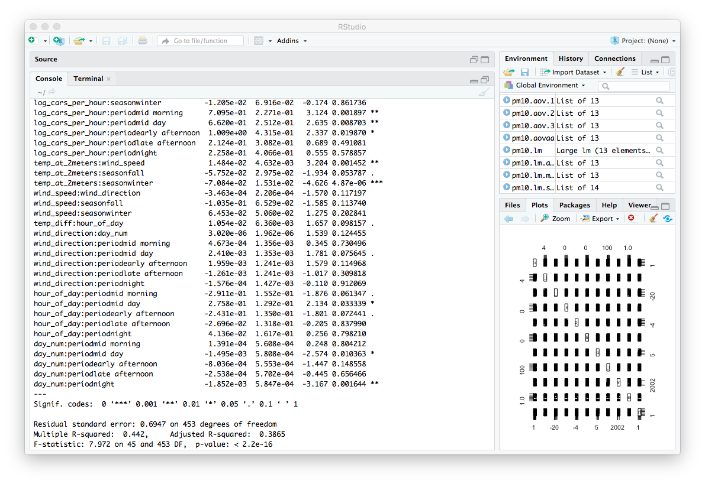

Slide 14
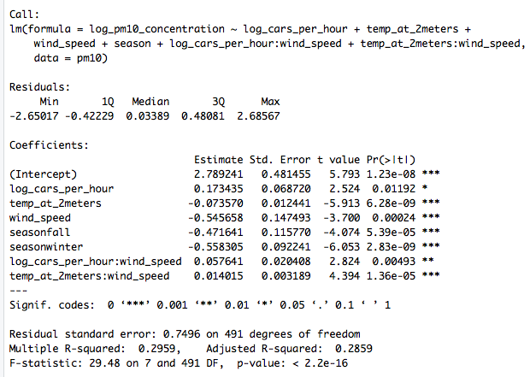
Linear Model w/ Interactions Manually Pruned
After examining the model produced using stepwise regression, I incrementally reduced the variable set of that model according to p-value significance until all terms were significant.

Slide 16
Model Comparisons
 | Model #1 (w/out interactions) | Model #2 (w/ interactions) | Model #3 (w/ interactions)
Adjusted R-squared | 0.2328 | 0.3865 | 0.2859
F-statistic | 31.22 | 7.972 | 29.48

Slide 17
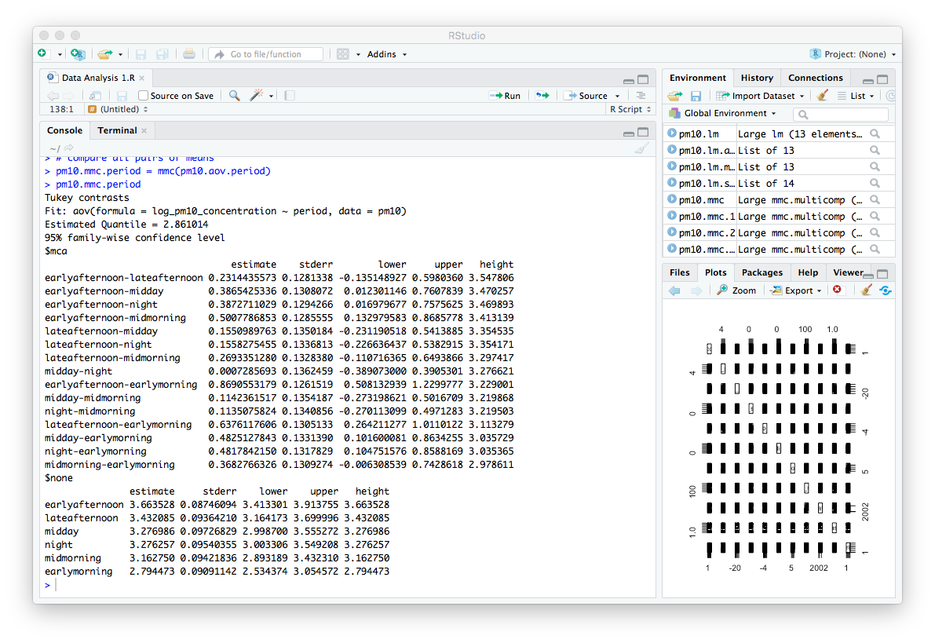
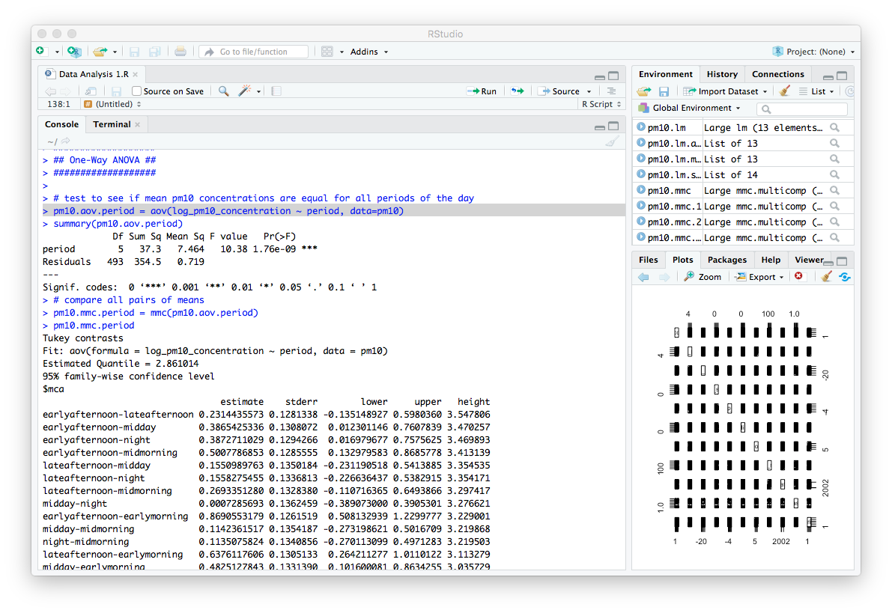
One-Way ANOVA Periods of the Day
Blue arrow indicates no difference in average PM10 concentration between the two levels being compared.
Test to see if mean PM10 concentrations are equal for all periods of the day.

Slide 18
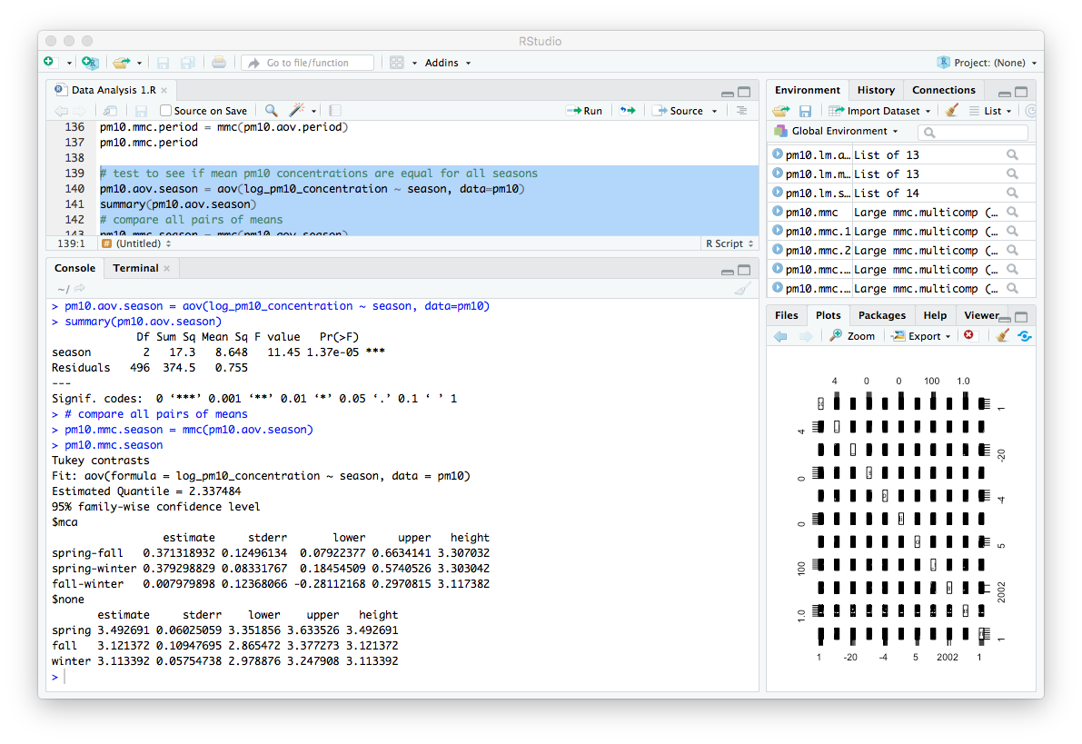
One-Way ANOVA Seasons
Blue arrow indicates no difference in average PM10 concentration between the two levels being compared.
Test to see if mean PM10 concentrations are equal for all seasons.

Slide 19
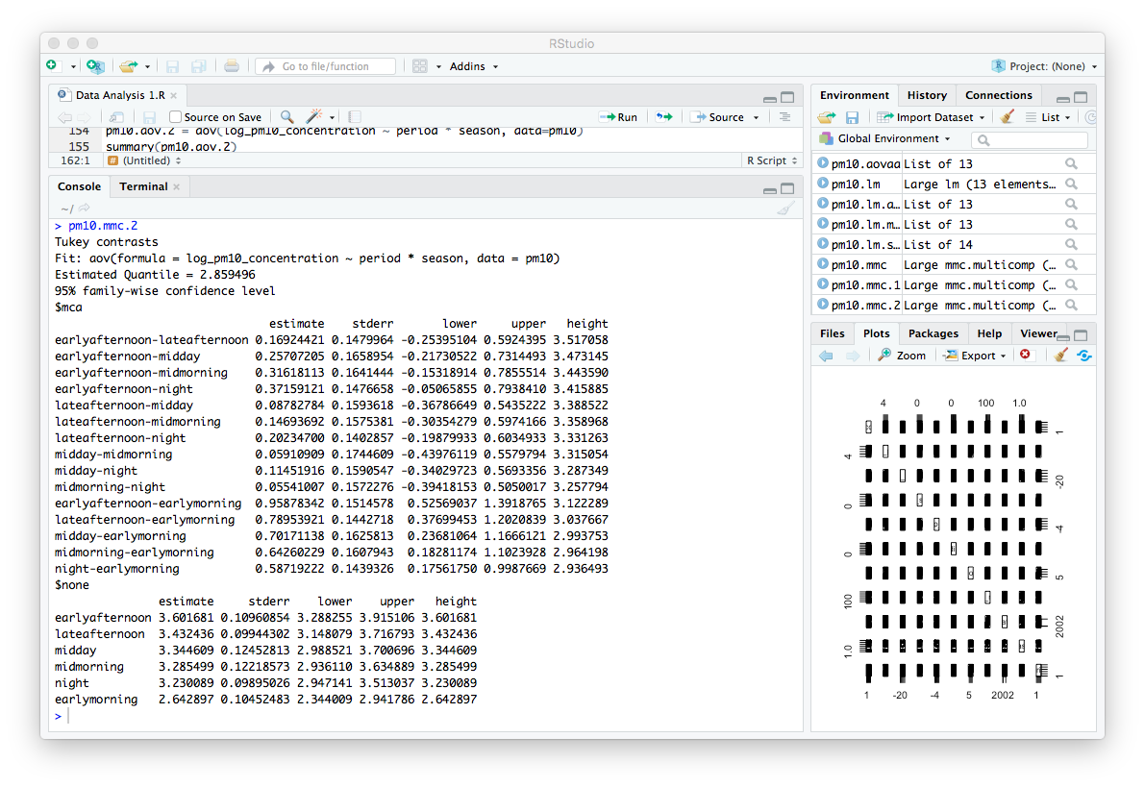
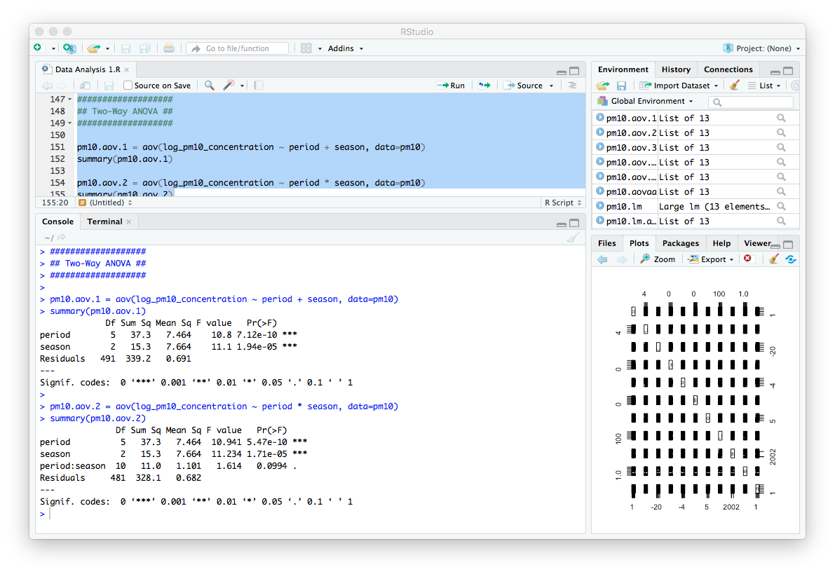
Two-Way ANOVA
Blue arrow indicates no difference in average PM10 concentration between the two levels being compared.
Determine if average PM10 level is equal among interactions between period of day and season.

Slide 20
Conclusions
Objective 1:
Based on the linear models produced and the associated diagnostic plots, a linear model is suitable though it only captures approximately up to 30% of the variability of PM10 concentration.
Conservative interpretation of Model #3: As the number of cars that pass per hour increases and as the wind speed and temperature just above ground decrease, PM10 concentration increases.
Objective 2:
Average PM10 concentration is not equal throughout the day.
Average PM10 concentration is not equal among all seasons.
Average PM10 concentration is not equal among all interactions between period of day and season.

